Slide 1
Intro to html
MCNDHS
Ms. Eng

Slide 2
aim: How do we preview our html code?
Do now:
Grab YOUR laptop
Turn on the computer
Open the folder that we created last night
Daily Grade:
On-time/attendance/not leaving the classroom: 25%
Cellphones: 25%
Notes:25%
Classwork/Homework: 25%

Slide 3
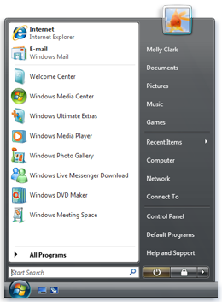
creating an html file on notepad
step 1: click on start
step 2: type in notepad

Slide 4
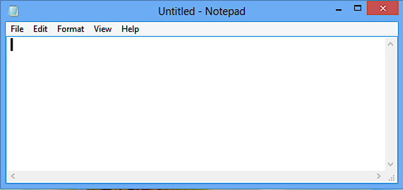
once you have notepad opened

Slide 5
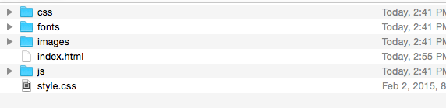
Creating your index.html file
what is the index.html file?
This is the name of your homepage

Slide 6
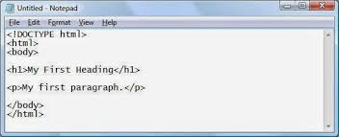
type this

Slide 7
saving your index.html

